Slide 1


Automatic LBW Decision Making using Image Processing
PRESENTED BY GUIDED BY
Selvavignesh S (18ECR187) DR. P. Nirmala Devi
Tharun Balaji S (18ECR223) (Professor/ ECE)
Vijay E (18ECL256)
Department of Electronics & Communication Engineering

Slide 2
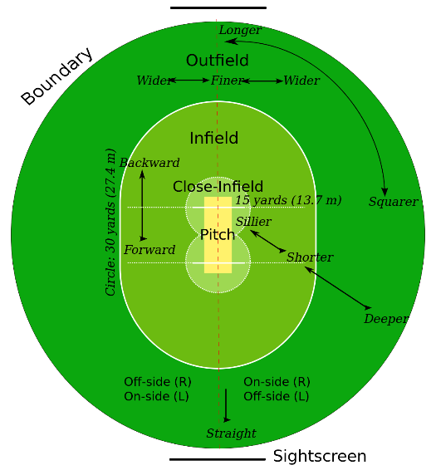
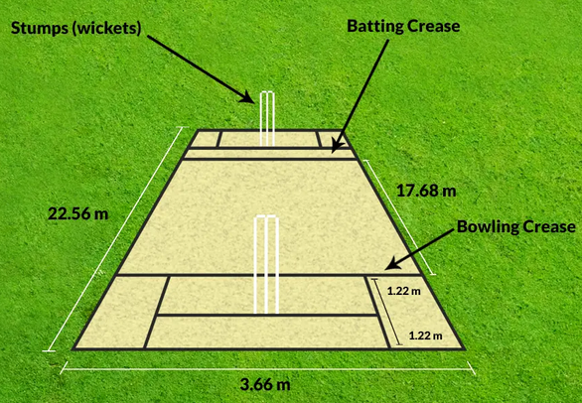
INTRODUCTION
Cricket
Cricket is an international game, most commonly played sport all over Asia.
Two teams consisting of 11 players each & 2 in-field umpire.
Bowler will bowl the ball and batsman saves the stump.
Pitch Cricket Field
Some batsman dismissal rules are Run-out, LBW, Catch-out etc.,
An in-field umpire makes final decision

Slide 3
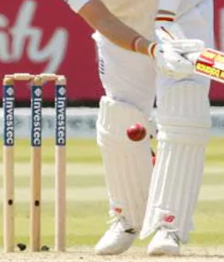
INTRODUCTION – contd..,
Leg-Before-Wicket (LBW)
One of the batsman dismissal rule.
As when the ball hits the batsman stump the wicket is taken.
Batsman should not interrupt the ball after bowled with his body.
According to the Law 36, before a batsman can be dismissed LBW,
the fielding team must appeal to the umpire.
If the bowler delivers a no-ball, an illegal delivery, the batsman cannot be out.
Ball must pitch in line with or on the off side of the wickets.
Then the ball must strike part of the batsman's body without first touching his/her bat and have been going on to hit the stumps.
LBW Out

Slide 4
LITERATURE REVIEW
Title of the paper | Name of the journal, Vol. No, and Year | Methodology | Limitations
Hawk Eye: A Logical Innovative Technology Use in Sports for Effective Decision Making | Sport Science Review, vol. XXI, No. 1-2, April 2012 | Hawk Eye (3D model) | There may be wrong prediction caused by imperfections on the ground surface.
Automated Decisions in Aware Cricket Ground: A Proposal | International Journal of Information and Education Technology, Vol. 2, No. 3, June 2012 | Using Sensors | There will be noises.
A-Eye: Automating the role of the third umpire in the game of cricket | Expert Systems with Applications, Volume 39, Issue 13, 1 November 2012 | Object Detection | Implemented only for Run-out detection, not LBW decision.

Slide 5
SUMMARY FROM LITERATURE REVIEW
Although Hawk eye is very accurate in measuring the actual path of a ball, when it comes to predicting the future path of the ball, it is not as clear in some cases.
The predicted path of the ball is based on the average and expected pathway and does not take into effect any deviation that can be caused by imperfections on the ground surface.
On other hand, Snicko-meters or other sensors will give additional noise which leads to wrong detections.

Slide 6
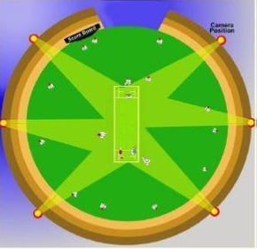
DRAWBACKS OF HAWK-EYE
More Expensive:
Number of high-speed cameras needed to implement the Hawk-Eye method which will be expensive.
The professional Hawk-eye method for a Standard Tennis court
takes 60,000 to 70,000 USD.
More Computation:
It needs to work on several images and timing constraints in order to generate a model.
It then, generates a 3D model from the resultant videos and timing data in order to provide output to check whether ball will hit the stump.
These processes will take more computation and storage, which will also be expensive.
Hawk-Eye Method

Slide 7
DRAWBACKS OF HAWK-EYE – Contd.,,
Never work on some Natural conditions:
Wind: Wind will affect the projection of the ball, it will result in error.
Pitch Conditions: When the pitch have patches/cracks, there will be change in projection after the ball pitches. Illumination: Hawk-eye method requires more illumination or light source in order to make accurate decisions.
Not Accurate:
Since, Hawk-eye method computes the projection of the ball (prediction), there may be some deviations of the ball on actual scenario. Hence, it would not be much accurate.
It is accepted that there will be 5mm to 15mm error deviation in detection. This could even change the victory of a team.

Slide 8
RESEARCH GAP
There is no improvement in Third umpire automation after the successful implementation of No Ball and LBW (Hawk eye method) detection in cricket.

Slide 9
OBJECTIVE
To make LBW automation using Image processing techniques.

Slide 10
EXISTING METHOD
In-Field Umpire Decision
Umpire is a person who has the authority to make decisions.
Two umpires on the field, one standing at Bowler's end and other at opposite end.
If the umpire is not sure about his decision or the player is not sure about in-filed umpire decision, Third umpire review or Umpire Decision Review System (UDRS) is called.
Umpire Decision Review System (UDRS)
The UDRS or simply DRS is a technology-based system used in cricket to assist the match officials with their decision-making.
The main elements that have been used are television replays, technology that tracks the path of the ball and predicts what it would have done, microphones to detect small sounds made as the ball hits bat or pad.

Slide 11
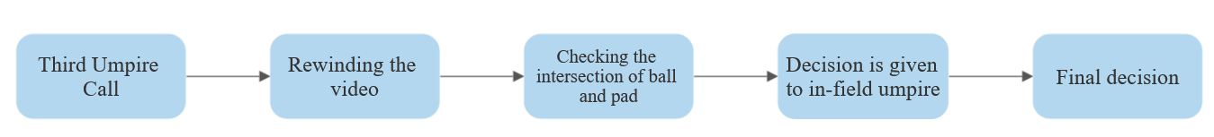
EXISTING METHOD – contd..,
LBW in UDRS
LBW is the hardest decision making for an in-field umpire.
So, most of LBW decisions will be called for DRS.
The third umpire checks for No-ball, whether the ball pitches in-field and uses Hawk-Eye method.
The basic approach by third umpire,

Slide 12
AUTOMATION IN UDRS
Third umpire sitting on the review panel watching slow motion video may not be able to make actual decision in all cases. Human will make errors time-to-time. Such errors may change the rest of the game.
The third umpire should make their decision within 45 seconds. It’s a rule that the third umpire review should not take more than 45 seconds, in order to retain the phase of the game. It’s really a challenging work for a human in more complicated decision calls.
A team can claim DRS only twice. There are cases that batsman knew he was not out but the wicket was taken out, since the two chances have been used.
It’s the right of the batsman to make call for a third umpire review, which will be violated on limited DRS calls.
A third umpire’s salary will be about 3 to 5 lakhs INR for a match.
Thus, the implementation of the Image processing and computer vision over comes the drawbacks.

Slide 13
PROPOSED METHOD
As defined in LBW law, there should be an intersection of ball and pad.
If it intersects, it is a LBW out. Else, it is not out.
The first step is to detect the ball and pad or leg
Then applying some logic to find whether the detected ball and pad intersects.
The proposed method consists of 4 modules,
Frame Segmentation & Cropping module
Ball Detection module
Pad Detection module
Decision Making module

Slide 14
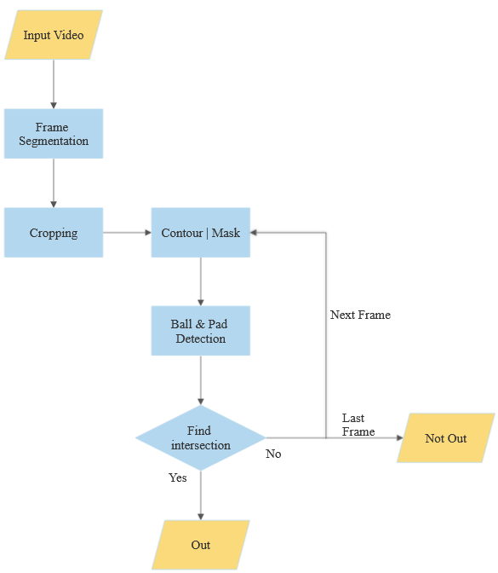
PROPOSED ARCHITECTURE
14/30

Slide 15
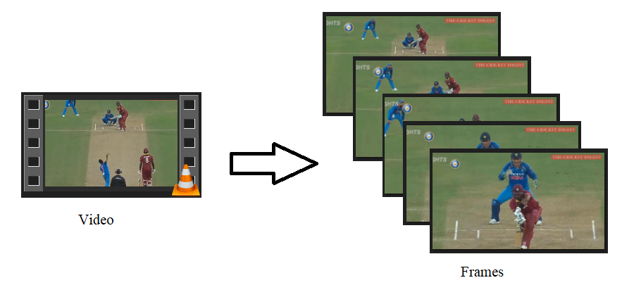
FRAME SEGMENTATION & CROPPING MODULE
Frame Segmentation
A particular portion of video is given as input.
Video is the consequent collection of images (frames) taken at particular interval of time.
This module reads the video segment and extracts the frame
Extraction can be varied on frames per second.
Cropping
Cropping is the removal of unwanted outer areas of image.
Image is a matrix, it can be cropped by limiting the index values.
The cropping of segmented frames will be done focusing the pitch and the batsman.
The cropped frame stored in a specified location.
Video Representation
15/30

Slide 16
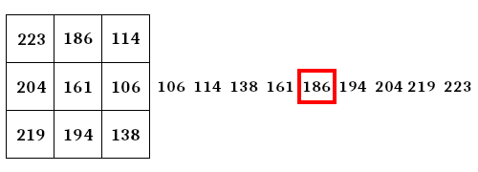
BALL DETECTION MODULE
Median Blur
Often used to remove noise from an image.
Pre-processing step to improve the results of edge detection on an image.
It preserves edges while removing noise.
Canny Edge Detection
Canny edge detection is a technique to extract useful structural information from different vision objects.
Canny operator is done before finding contour in an image
It improves the contour edges and helps in shape detection.
Median Blur
16/30

Slide 17
BALL DETECTION MODULE – contd..,
Contour
Widely used for systematically refining object contours.
Basic concept is to obtain a complete and accurate outline of an object.
The contour is a useful tool for shape analysis and object detection and recognition.
A starting approximation is made, either by initiating a large contour that may be shrunk to size, or a small contour that may be expanded suitably, until its shape matches that of the object.
Compared to classical feature extraction techniques, contours have multiple advantages:
They autonomously and adaptively search for the minimum state.
External image forces act upon the snake in an intuitive manner.
Incorporating Gaussian smoothing in the image energy function introduces scale sensitivity.
They can be used to track dynamic objects.

Slide 18
BALL DETECTION MODULE – contd.,,
Minimum Enclosing Circle
Mathematical method of computing the smallest circle that contains all of a given set of points.
Finds the minimum circle associated with the contour
It provides the center and radius of the detected circle in terms of pixel position.
With the center and radius, a bounding circle is drawn over the contour.
Instead of using bounding boxes, bounding circle is used to make accurate predictions.
This detected circle (ball) will be used in decision making module.

Slide 19
PAD DETECTION MODULE
Color Masking (Image Segmentation Based on Color)
Partitioning a digital image into multiple segments is defined as image segmentation.
Based on the color feature of image pixels.
Homogeneous colors in the image correspond to separate clusters as objects.
Based on the track pant and cricket pad of the batsman, it is possible to extract its segment.
Depending on the lower boundary and upper boundary shades of that color, we can get the proper shape of the pad and leg.
LBW out, even the ball touches the batsman leg.
The regions other than the pad and the leg will be black.
By applying the mask we can eliminate the detection of bat, stump, crease line and other unwanted objects

Slide 20
PAD DETECTION MODULE – contd..,
Median Blur
After color mask, the other pixels or noise may consist of values we set as boundaries.
It weaken or removes the unwanted edges/ spikes of pixels near the pad.
By this, we can get a better outline of the obtained leg and pad segments.
Thresholding
The blurred pixels or noise in the previous image can be removed by applying thresholding.
Thresholding removes the weak pixels obtained from blurring
The resultant image will get detailed.

Slide 21
DECISION MAKING MODULE
Make decision based on intersection of detected ball and detected pad.
From ball detection module, the detection of ball is represented by bounding circle.
From pad detection module, mask of the pad is obtained.
Thus, we have two masks representing the detected ball and pad.
The masks are applied with pixel wise AND operation.
Both the pixels in the pad’s mask and ball’s mask should be 1, so that the edges of the ball and pad intersects.
The resultant mask obtained on pixel wise AND logic, shows the intersection area.
If there will be any pixel’s value is 1, then there is intersection and returns out.
Else, the decision making of next frame will be continued.

Slide 22
TOOLS USED
OpenCV (Python)

Slide 23
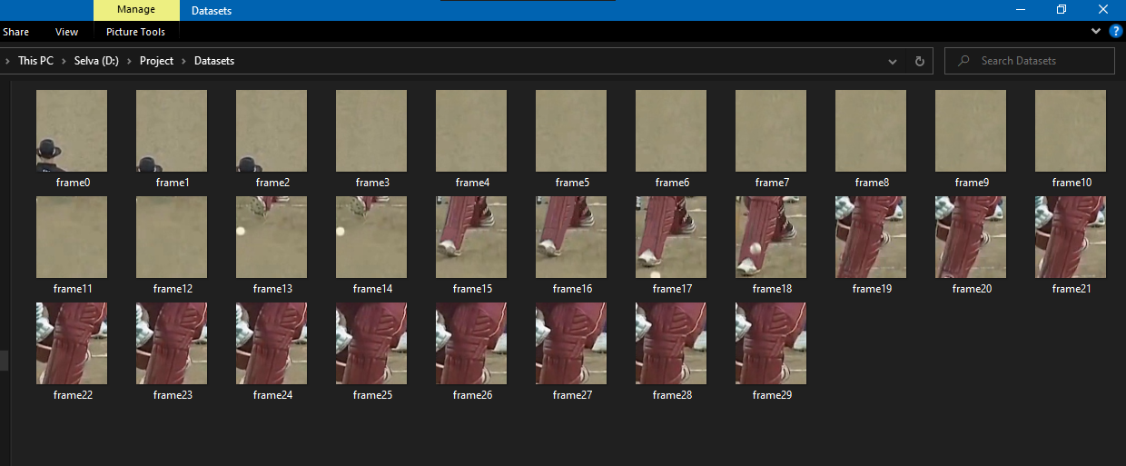
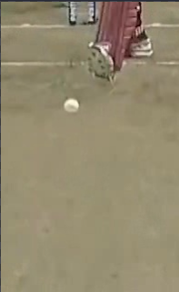
RESULTS
Results of Frame segmentation & Cropping module:
Cropped image Frames stored in specified location

Slide 24
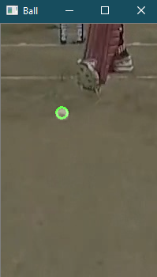
RESULTS – contd.,,
Results of Ball Detection module:
Input (Cropped Image) Ball Detection ( Output)

Slide 25
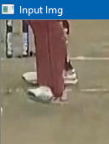
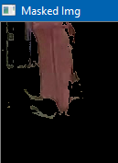
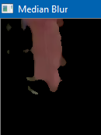
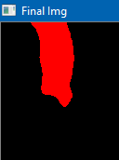
RESULTS – contd.,,
Results of Pad detection module:
Input Image Mask Applied Blur Applied Detected Pad Selva (Output)

Slide 26
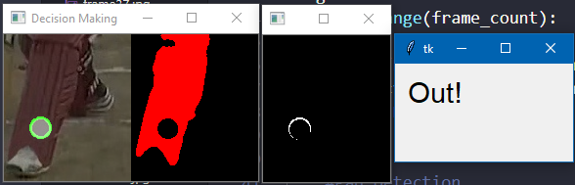
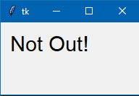
RESULTS – contd.,,
Results of Decision Making module:
Decision Making at intersection point Without any intersection

Slide 27


RESULTS – contd.,,
Execution Time
With Frame Segmentation
Without Frame Segmentation

Slide 28
REFERENCES
[1] Hawk Eye: A Logical Innovative Technology Use in Sports for Effective Decision Making, Sport Science Review, vol. XXI, No. 1-2, April 2012.
[2] Automated Decisions in Aware Cricket Ground: A Proposal, International Journal of Information and Education Technology, Vol. 2, No. 3, June 2012.
[3] A-Eye: Automating the role of the third umpire in the game of cricket, Expert Systems with Applications, Volume 39, Issue 13, 1 November 2012.
[4] Detecting Third Umpire Decisions & Automated Scoring System of Cricket, International Conference on Computer, Communication, Chemical, Materials and Electronic Engineering (IC4ME2), 11-12 July, 2019.
[5] M. A. Shahjalal, Z. Ahmad, R. Rayan and L. Alam, "An approach to automate the scorecard in cricket with computer vision and machine learning," 2017 3rd International Conference on Electrical Information and Communication Technology (EICT), 2017
[6] DR. JAYESH N. MODI1DR. VISHAL H. BHEMWALA, Comparisons of Advanced Computing Technique used in Cricket Game, International Journal of Research in all Subjects in Multi Languages,2020
[7] Khan W.Z, Aalsalem Y and AinArshad Q The Aware Cricket Ground International Journal of Computer Science Issues 2011.
[8] Stefano Pagnottelli , An Effective Ball Detection Framework for Cricket International Journal of Computer Science Issues, 2010.

Slide 29
REFERENCES – Contd.,,
[9] Md. Kowsher, M Ashraful Alam, Md. Jashim Uddin, Faisal Ahmed, Md Wali Ullah and Md. Rafiqul Islam, Detecting Third Umpire Decisions & Automated Scoring System of Cricket Int. Conf. on Computer, Communication, Chemical, Materials and Electronic Engineering (IC4ME2), Rajshahi, Bangladesh, 2019.
[10] Vinesh, C. H., & Sujatha, B. M. Smart Third Umpire Decision Assisting system using PLC. International Journal of Engineering Research in Computer Science and Engineering, 2015.
[11] W. Rong, Z. Li, W. Zhang and L. Sun, "An improved Canny edge detection algorithm," 2014 IEEE International Conference on Mechatronics and Automation, 2014.
[12] Wikipedia contributors. (2021, February 24). Leg before wicket. Wikipedia. https://en.wikipedia.org/wiki/Leg_before_wicket.
[13] Wikipedia contributors. (2021b, April 11). Canny edge detector. Wikipedia. https://en.wikipedia.org/wiki/Canny_edge_detector
[14] OpenCV: Creating Bounding boxes and circles for contours. (2019, April 1). In docs.opencv.org. https://docs.opencv.org/3.4/da/d0c/tutorial_bounding_rects_circles.html
[15] OpenCV: Canny Edge Detector. (2019). Docs.Opencv.Org. https://docs.opencv.org/3.4/da/d5c/tutorial_canny_detector.html
[16] Balasubramanian, R. (2020, December 16). Object Tracking Using OpenCV - Analytics Vidhya. Medium. https://medium.com/analytics-vidhya/object-tracking-using-opencv-f28a7e09219d
[17] Maulion, M. (2021, February 2). Color Image Segmentation — Image Processing - Matt Maulion. Medium. https://mattmaulion.medium.com/color-image-segmentation-image-processing-4a04eca25c0

Slide 30
THANK YOU

